Slide 1

Cluster in 5 minutes
@kunalkushwaha
Docker & Rancher-os
@kunalkushwaha

Slide 2
So what we saw in last 5 minutes?
@kunalkushwaha
cluster of docker host in 3 commands.
No extra software
Cluster
Declarative service model
Desired state reconciliation
Multi-host networking
Service discovery
Load balancing
Secure by default
Rolling updates
Notes:
So what we saw in this 5 minute demo?
This demo is running 3 instances of RancherOS. I was supposed to bring my raspberryPi cluster, but for demo, I just used VM instances.
We build a cluster if docker host in 3 commands.. just 3 commands.
No extra software we installed or configured for this.
Well how well is this cluster?
It has declarative service modal i.e. when I create a service, it declares a service with desired properties like, what port should be exposed, how many instances it should run, how it should get deployed etc.
Its swarm, which monitors the state of service and reconcile to desired state.
i.e. if any instance of service stops, it will create new instance automatically.
In this demo, Did i configured any networking thing?
No. But still my service got deployed on multiple nodes and load balancing, service discovery happens automatically. Internally it uses overlay network and IPVS to achieve that.
Security!
This is big concern, whether you run any software at home or office.
Securing cluster is again a big task.
Docker swarm is secure by default.
When we do docker swarm init
“a TLS root CA (Certificate Authority) gets created”
Then a key-pair is issued for the first node and signed by root CA.
when new node joins, they issues their own keypair, signed by the root CA, and they also receive the root CA public key and certificate.
All the communication is encrypted over TLS.
The node keys and certificates are automatically renewed on regular intervals (by default 90 days)
and At last we saw the Rolling updates too.
I guess that was quite a lot we achieved in 5 minutes. Isn’t it?

Slide 3
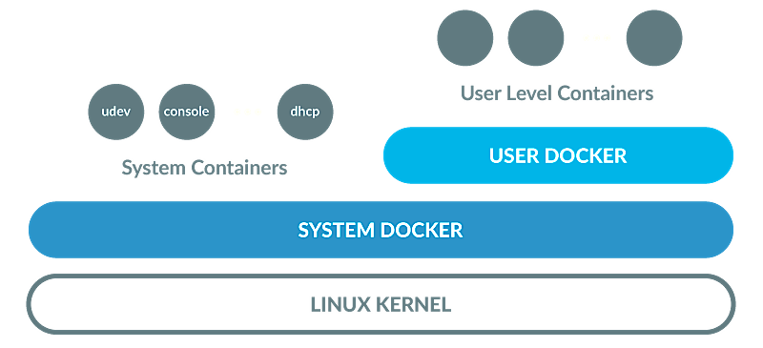
rancher-OS
@kunalkushwaha
Small but updated and stable.
Build for Containers.
Minimum overhead - great for low powered and old hardwares.
Docker is first class citizen
Easy upgrade and rollback of docker engines.
Support for Raspberry PI and ARM..
Size 40 ~ 60 MB
Notes:
Now why RancherOS?
- RancherOS is designed specially for Docker Host.
Everything in RancherOS is a container.
One instance of Docker runs directly on the kernel, replacing the traditional init system
System services like dev, console, dhcp etc runs as privileged containers on System Docker.
User containers run inside a separate daemon we call User Docker.
This is also great for old and low powered hardwares like raspberryPI.
RancherOS provides multiple options for docker engine, and you can switch engines with one command without reboot.
OS and docker upgrade is very easy and rollback is possible if something went wrong.
Builds for ARM and RaspberryPI is available.
Very small size around 40~60 MB.
Highly recommend to play around with it, you will love it.

Slide 4
@kunalkushwaha
“Choose right tools for job!”
Notes:
At end, just want to say, Choose right tools for jobs.
Focus on what you want to solve rather then getting lost in tool to solve the problem.
Docker and Rancher both help you to focus.
Thanks you.

